Slide 1


IMDB Movie Analysis
Presenter
Indu Prakash G

Slide 2
Contents:
Project Description
Tech Stack Used
Approach
Insights
Results and Conclusion
Presentation Title

Slide 3

Project Description:
The IMDb Movie Analysis project aims to explore and analyze a comprehensive dataset of movies available on the IMDb platform.
This dataset contains essential information about movies, including director names, movie titles, duration, genre, budget, gross earnings, IMDb ratings, and more.
Through in-depth data analysis using Excel, Data Visualization and Statistics techniques this project seeks to extract valuable insights and trends that contribute to a movie's success.

Slide 4



Software Used:
Microsoft Excel 365

Slide 5
1) Movie Genre Analysis:
Analyze the distribution of movie genres and their impact on the IMDB score.
Task: Determine the most common genres of movies in the dataset. Then, for each genre, calculate descriptive statistics (mean, median, mode, range, variance, standard deviation) of the IMDB scores.

Slide 6
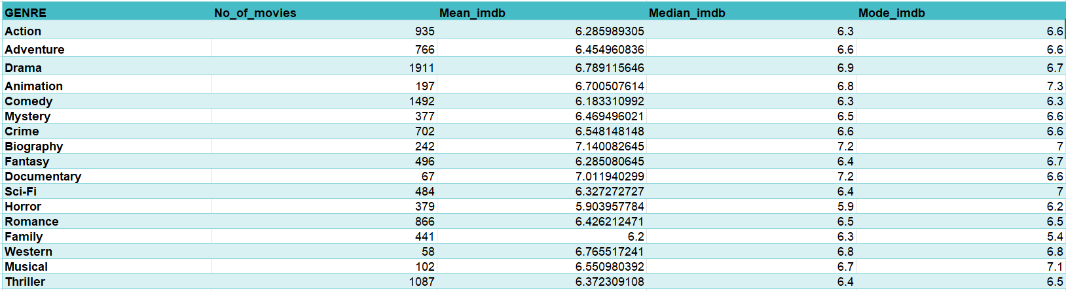
Result:

Slide 7
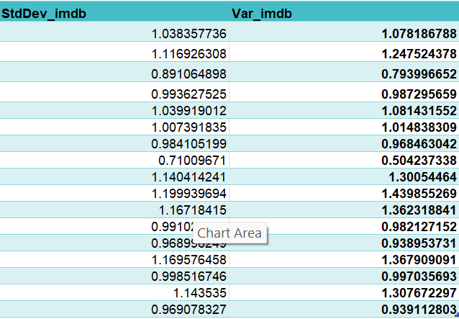
Result:

Slide 10
2) Movie Duration Analysis:
Analyze the distribution of movie durations and its impact on the IMDB score.
Task: Analyze the distribution of movie durations and identify the relationship between movie duration and IMDB score.

Slide 11
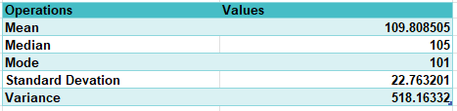
Results:

Slide 13
3) Movie Language Analysis:
Situation: Examine the distribution of movies based on their language.
Task: Determine the most common languages used in movies and analyze their impact on the IMDB score using descriptive statistics.

Slide 14
Results:

Slide 15
4) Movie Director Analysis:
Influence of directors on movie ratings.
Task: Identify the top directors based on their average IMDB score and analyze their contribution to the success of movies using percentile calculations.

Slide 16
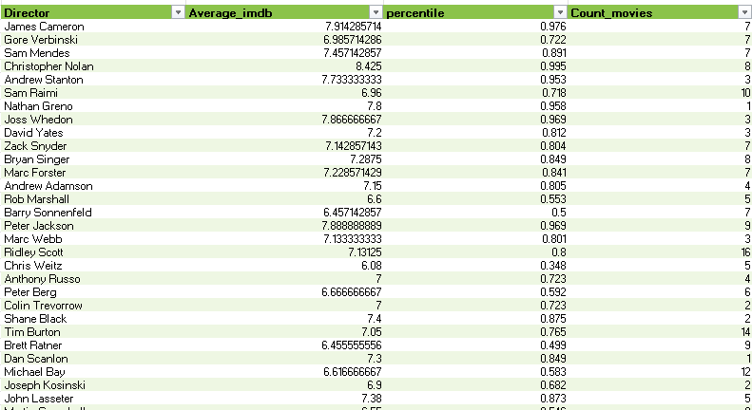

Slide 17
5) Movie Budget Analysis:
Explore the relationship between movie budgets and their financial success.
Task: Analyze the correlation between movie budgets and gross earnings, and
identify the movies with the highest profit margin.

Slide 18
Movies | Profits in Millions
AvatarÂ | 523505847
Jurassic WorldÂ | 502177271
TitanicÂ | 458672302
Star Wars: Episode IV - A New HopeÂ | 449935665
E.T. the Extra-TerrestrialÂ | 424449459
The Lion KingÂ | 377783777
The Jungle BookÂ | 375290282
Star Wars: Episode I - The Phantom MenaceÂ | 359544677
The Dark KnightÂ | 348316061
The Twilight Saga: Breaking Dawn - Part 2Â | 344597846

Slide 20

Insights
The Most common movie genres from the dataset are Drama, Comedy, Thriller and Action.
The Average duration of a Movie is 109 minutes. The trendline between the duration vs imdb score is elevated upward with R^2 = 0.131
The Most common languages used in the movies are English, French, Spanish, Mandarin and German. I have also Observed that the languages Telugu and Persian have the highest average imdb score.
I have identified that Tony Kaye, Charles Chaplin, Alfred Hitchcock, Ron Fricke, Damien Chazelle, Majid Majidi, Sergio Leone, Christopher Nolan, SS Rajamouli and Richard Marquand are the top 10 directors with average imdb score >=8.4
The Top-5 with highest profits are Avatar, Jurassic World, Titanic, Star Wars: Episode IV - A New Hope and E.T. The Extra-Terrestrial. The Correlation between budget and gross is positive.

Slide 21




Thank you

